Slide 1
Software Project Presentation
Jonathan Russell
University of Arizona Global Campus
CST499: Capstone for Computer Software Technology
Dr. Amr Elchouemi
January 24, 2022

Slide 2
Agenda
Summarize the key aspects of the SRS document
Showcase the UML design model
Explain the design of the landing, login, and enrollment pages
Explain the MySQL database and class registration
Discuss the PHP code

Slide 3
The SRS Document – Student Web Registration System
The software requirements specification (SRS) defines the functionality that the newly created software will be responsible for.
Part 1: Landing, Log In, Enrollment Functionality
Unique Email Address
Part 2: Course Registration Functionality
Course Max Capacity
Notification to Next Student in Line
Remove Registered Course

Slide 4
UML – Design Model - Types
Three Types Included
Sequence Diagrams (Behavioral)
Use Case Diagram (Behavioral)
Class Diagram (Structural)

Slide 5
Part 1: Landing, Login, & Enrollment - Overview
HTML Page Responsibility
Landing – Default index.php Page
Login – login.php processes the HTLM form for logins
Enrollment – registration.php processes the HTML form for new student registrations

Slide 6
Landing Page
Provides a menu and a basic welcome
Session = False, there is an option to:
Enroll
Login
Session = True, there is an option to:
Logout
View Profile
Register
View Schedule

Slide 7
Enrollment Page
Provides a menu and a basic welcome
Session = False, there is an option to:
Enroll – HTML Form is available to Enroll
Login
Session = True, there is an option to:
Logout
View Profile
Enroll
View Schedule

Slide 8
Login Page
Provides a menu and a basic welcome
Session = False, there is an option to:
Enroll
Login

Slide 9
Part 2: Registration - Overview
HTML Page Responsibility
Course Catalog (catalog.php)
View Course Catalog (Categorized by Semester)
Add Courses to Student Schedule
Class Schedule (classes.php)
View Class Schedule
Remove Courses from Schedule

Slide 10
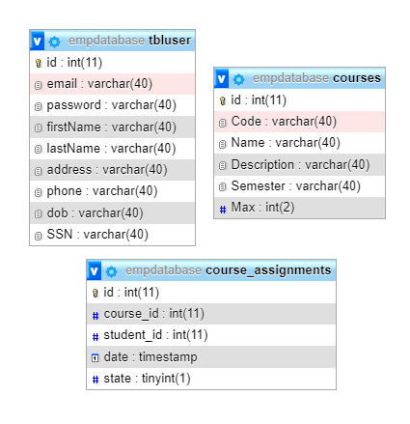
MySQL Database – Student Registration System
Main Purpose: Data Persistence
Three Tables
tbluser
Many to Many
student enrollment & login
courses
Many to many
University Catalog
course_assignments
One to one relationship
Student Schedule
Max Capacity Integrity

Slide 11
Tools Used – Implementation
phpMyAdmin – SQL Database Administration
IntelliJ IDEA – Java Edition (worked well for organizing, not syntax)
PHP Beautifier - https://codebeautify.org/php-beautifier
Textbook

Slide 12
PHP Code - Overview
Total of 10 Unique Files
dataaccess.php – All access to the database passes through
login.php – Authenticates Users (Session())
logout.php – Kills Session()
registration.php – Creates student profile in system
catalog.php – Displays University Catalog for selection
classes.php – Displays Scheduled Course and delete option
add.php – Helper PHP to insert course for student
reserve.php – Help PHP to reserve course at max capacity
delete.php – Removes course from schedule
index.php – Landing Page

Slide 13
PHP Code – Data Access PHP
Total of 10 Unique Files
searchUser() – Username/Password match = true?
getProfile() – Retrieves the profile of the current user session
executeQuery() – Used to insert profile data (not required scope)
checkUniqueEmail() – Used to enforce unique email requirement
getCourseCatalog() – Retrieves the catalog from the database
changeCourseToStudent() – Used to modify courses using helpers
getClasses() – Current Student Schedule
nextStudent() – Prepares notification

Slide 14
Thank you

